Slide 1

Manifest System
NexDigital

Slide 2

Who We Are?
NexDigital has been established since july 2013 and has been work on some Local project application or International project application web based as below :
Forex-Ask (http://forex-ask.com)
Instaforex-Malaysia (http://instaforex-malaysia.com)
E-Procurement Jamsostek
Our Vision
To grow both vertically and horizontally to establish ourselves on top as a preferred IT Solutions provider.
Our Mision
To Achieve excellence in providing the best IT solutions to customers to meet their present and future business needs in the most efficient and effective way

Slide 3
What we have?
Create a effective application and advance application to your business
Create a good design and compatible to device (mobile, tab and desktop version)
Digital Marketing

Slide 4

What We to do?
Record Manifest
Record Costumers
Notification
Manifest governance
Accept the Manifest
View all Manifest
View all Costumers
Print out Manifest
Print out the bill
Costumer governance
Alert Message

Slide 5
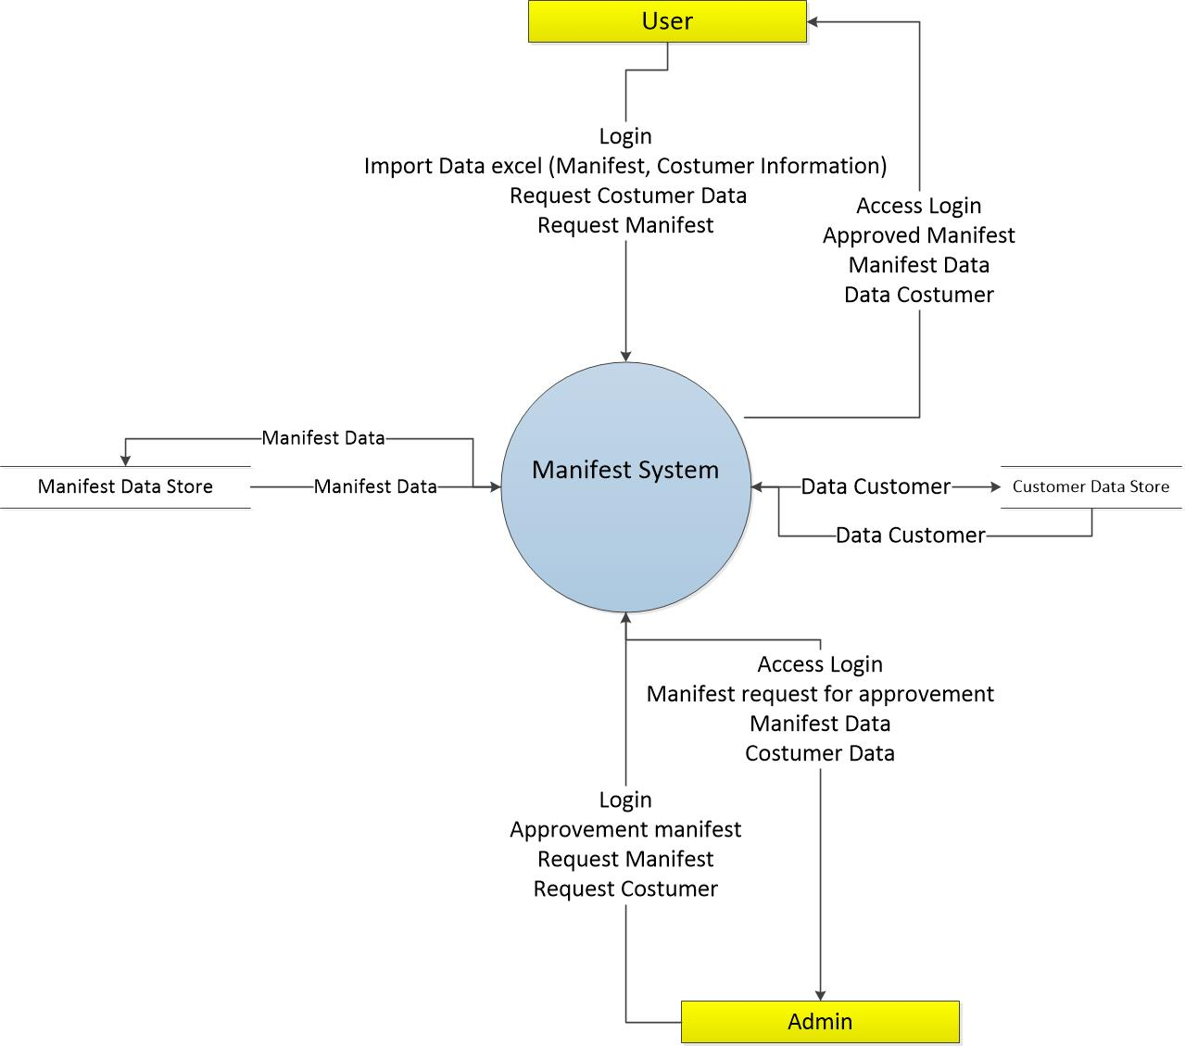
What we talking about?

Slide 6


